Slide 1
Gaming from Different Demographic Perspectives
By, Emeka Nwosu

Slide 2
The Video Game Industry
History
Economic growth
Diversification growth
Video games are everywhere

Slide 3
Research Question and Hypothesis
Different types of people = different gamers?
Application in marketing
Application in game development

Slide 4
Personal Connection
My history with video games
Gaming for me today
My interest in this topic

Slide 5
Plan and Design
Quantitative research
Descriptive analysis
Regression analysis

Slide 6
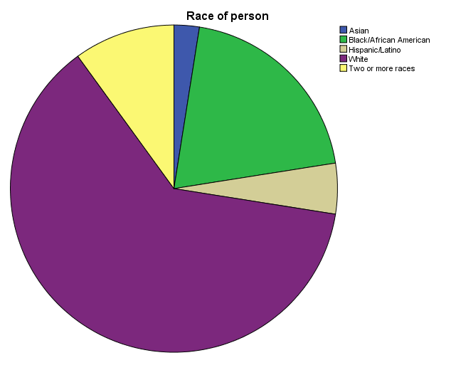
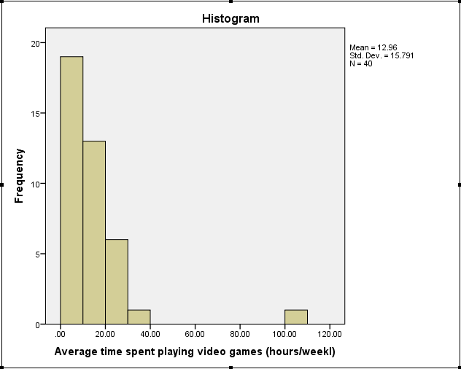
Results (Descriptive Statistics)

Slide 7
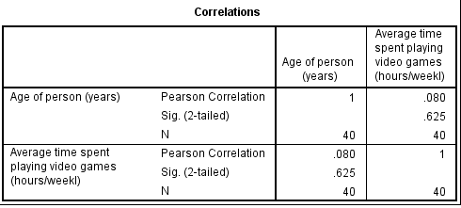
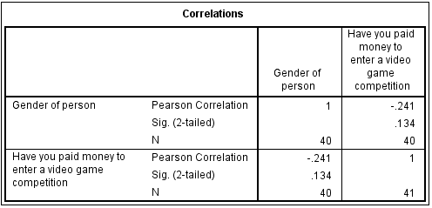
Results (Bivariate Statistics)

Slide 8
Qualitative Research
Fighting game community
Female competitive gamers

Slide 9
Conclusion
Age as an indicator of video game playing
Gender as an indicator of video game playing
Race as an indicator of video game playing

Slide 10
Limitations of Research
Sampling process and Sample Size
Logistics
Access to better data

Slide 11
Abbreviated Bibliography
http://auth-83051f68-ec6c-44e0-afe5-bd8902acff57.cdn.spilcloud.com/v1/archives/1384952861.25_State_of_Gaming_2013_US_FINAL.pdf
http://www.mitpressjournals.org/doi/abs/10.1162/pres.15.3.309
http://www.polygon.com/features/2014/2/6/5361004/fighting-game-diversity
http://learni.st/users/SteveSegovia/boards/28469-diversity-in-video-games-the-rise-of-female-gamers
http://www.theesa.com/facts/pdfs/esa_ef_2013.pdf

